Slide 1
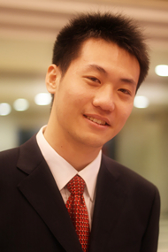
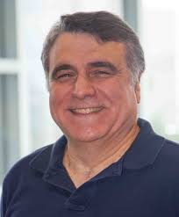


CATCHTARTAN:
Representing and Summarizing
Dynamic Multicontextual Behaviors
Meng Jiang (UIUC), Christos Faloutsos (CMU), Jiawei Han (UIUC)

Slide 2



What is Tartan?
Visited CMU in 2012-13
Watched lots of
Tartans’ games…

Slide 3
What is Behavior? Is it valuable?
Behavior: interactions made by individuals or organisms in conjunction with themselves or their environment. (Wikipedia)
Tweeting behavior
Publishing-paper behavior
20:03:09 @ebekahwsm
this better be the best halftime show ever in the history of halftimes shows. ever. #SuperBowl
2009 P. Melville, W. Gryc, R. Lawrence, “Sentiment analysis of blogs by combining lexical knowledge with text classification”, KDD’09. Refs: p81623, p84395…
Q: What can we discover from behavioral data?
Ex. Given every phone call / message between the military leaders, scientists, businesspersons, Find …

Slide 4

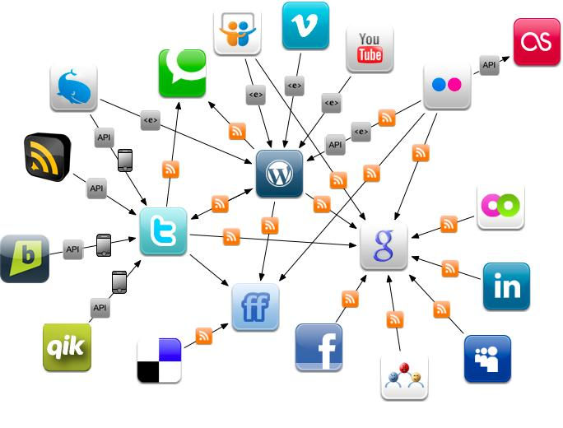
Why We Talk about Behavior Today?
Physical Environment
Online Environment
The human behaviors are broadly and deeply
recorded in an unprecedented level.
This is the first time that we can get insights of human behaviors and the society from large scale real data.

Slide 5
Representing and Summarizing Behavior
Representing
Raw data to Math
Summarizing
Patterns: trends, events, campaigns…
Understanding
Factors underlying the patterns: influence, intentions…
Predicting
What will happen in the future?
Intervening
Recommendation,
spam/fraud detection…

Slide 6
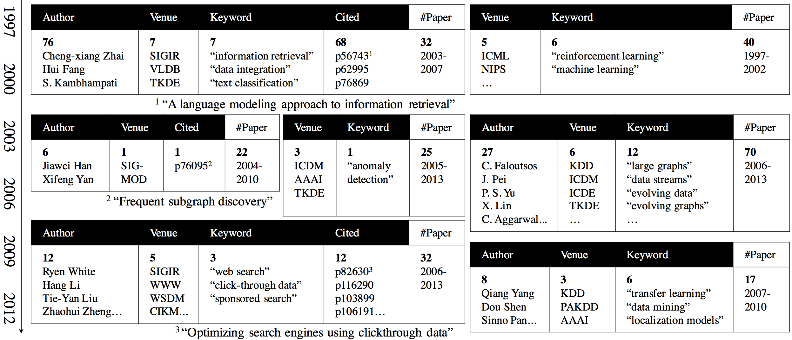
Given the behavioral data (e.g., DBLP data, tweets)
Return behavioral summaries (e.g., research trends, events)
2009 P. Melville, W. Gryc, R. Lawrence, “Sentiment analysis of blogs by combining lexical knowledge with text classification”, KDD’09. Refs: p81623, p84395…

Slide 7
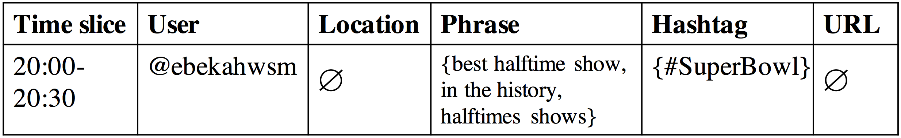
Behaviors: Dynamic and Multicontextual
Tweeting behavior
20:03:09 @ebekahwsm
this better be the best halftime show ever in the history of halftimes shows. ever. #SuperBowl
Contextual factors:
t
u
p
h
p
p
One-guaranteed
value
Empty (set
of) value
Empty (set
of) value
Set value
Dynamic

Slide 8
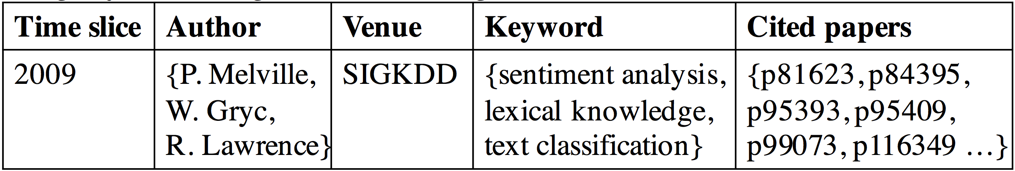
Behaviors: Dynamic and Multicontextual
2009 P. Melville, W. Gryc, R. Lawrence, “Sentiment analysis of blogs by combining lexical knowledge with text classification”, KDD’09. Refs: p81623, p84395…
Publishing-paper behavior
Contextual factors:
t
c
a
c
One-guaranteed
value
a
a
v
p
p
p
Set value
Set value
Set value
Dynamic

Slide 9
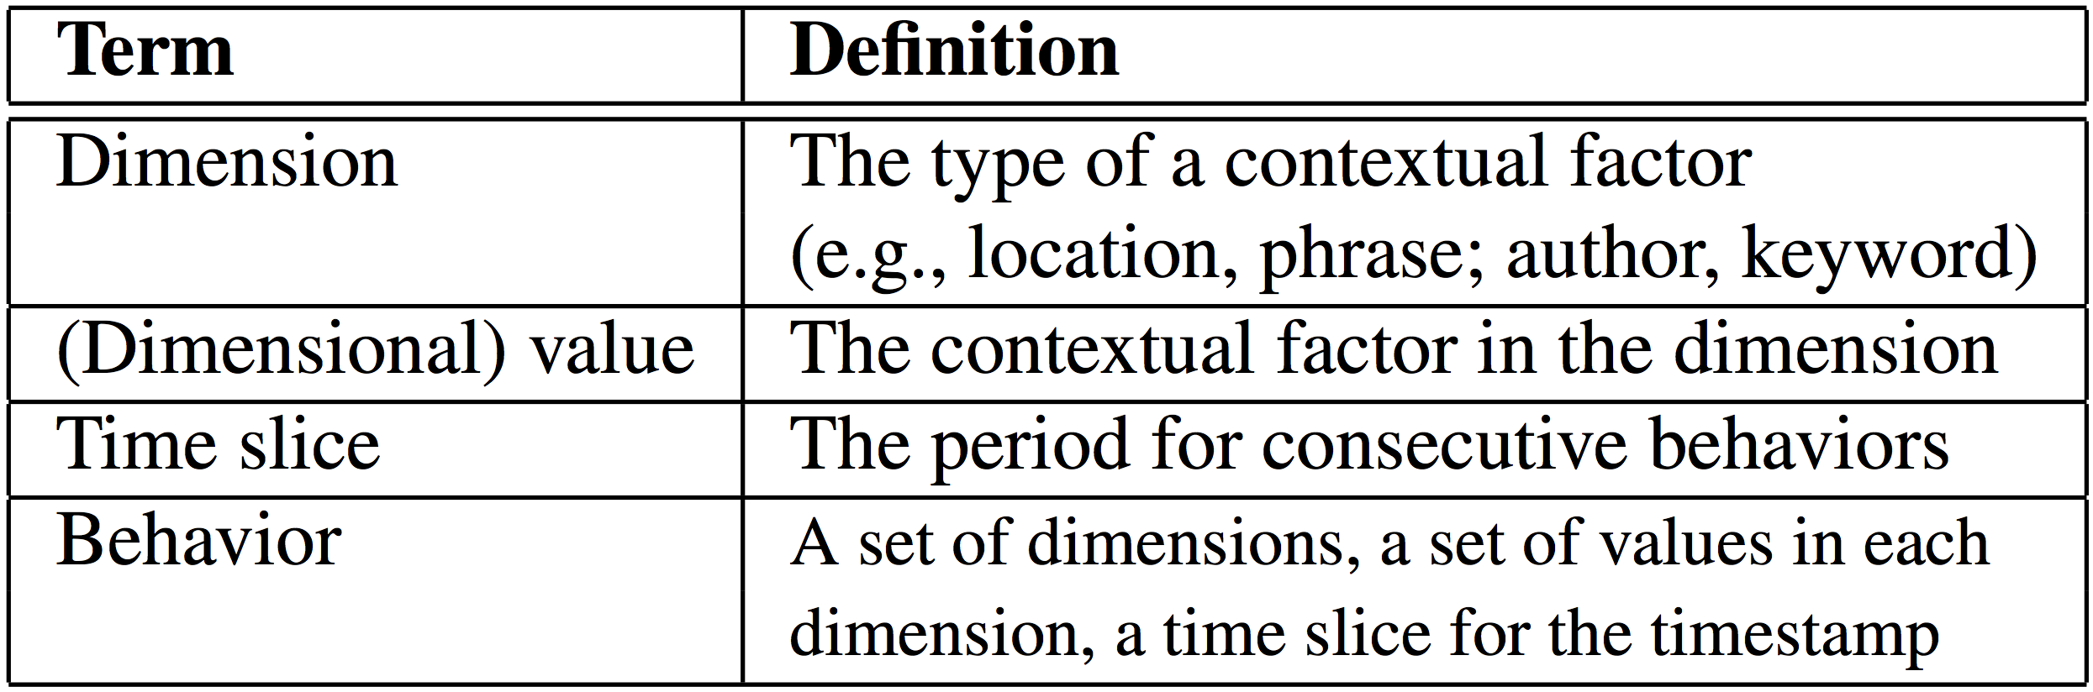
Summarizing Behaviors
Dynamic: taking a set of consecutive time slices
Multicontextual: taking a set of dimensions and a set of dimensional values in each dimension

Slide 10
Tensor Fails
Tensor - modeling multidimensions: FEMA (KDD’14), CrossSpot (ICDM’15)
Representation: (multicontextual)
Empty values?
∅
http://XXX.YYY
only $3.99
∅
Bob
∅

Slide 11
Tensor Fails (cont.)
Tensor - modeling multidimensions: FEMA (KDD’14), CrossSpot (ICDM’15)
Summarization: (dynamic)
Temporal patterns?
t₁₀
t₁₁
t₂₄
t₂₅
t₂₆
t₃₁
t₃₇
http://XXX.YYY
only $3.99
Bob

Slide 12
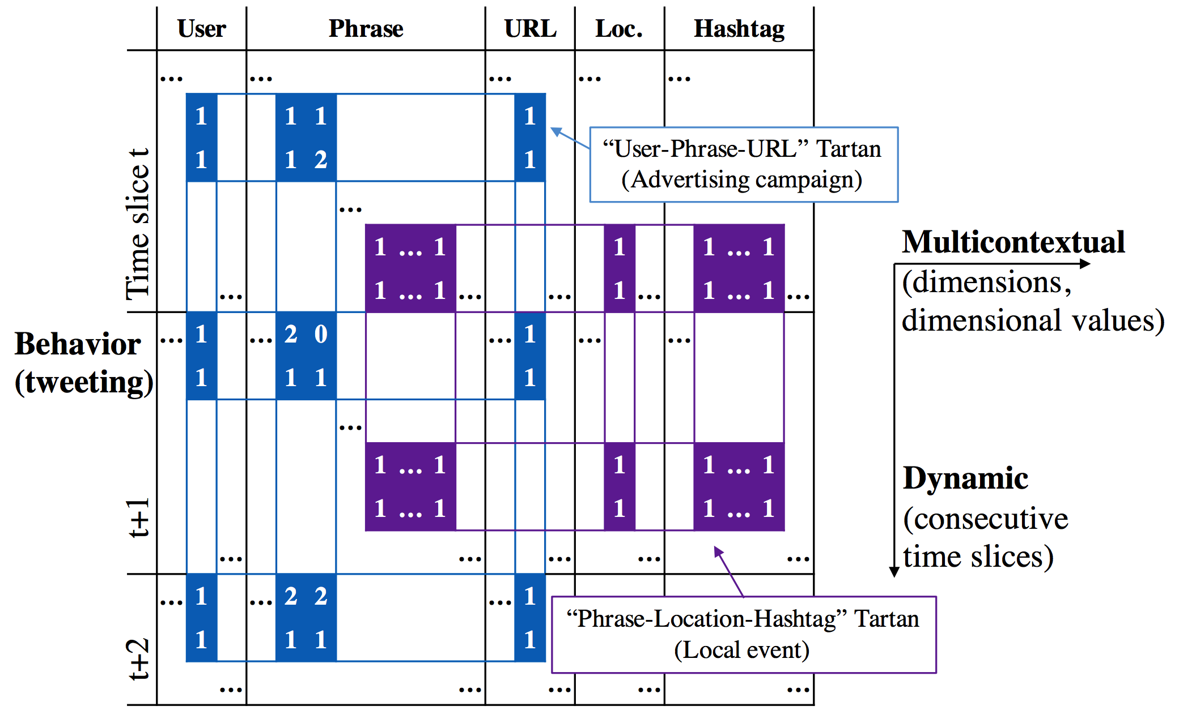
Our Representations for Behavior and Behavioral Summary
Behavior: “Two-level matrix”
Behavioral summary: “Tartan”

Slide 13
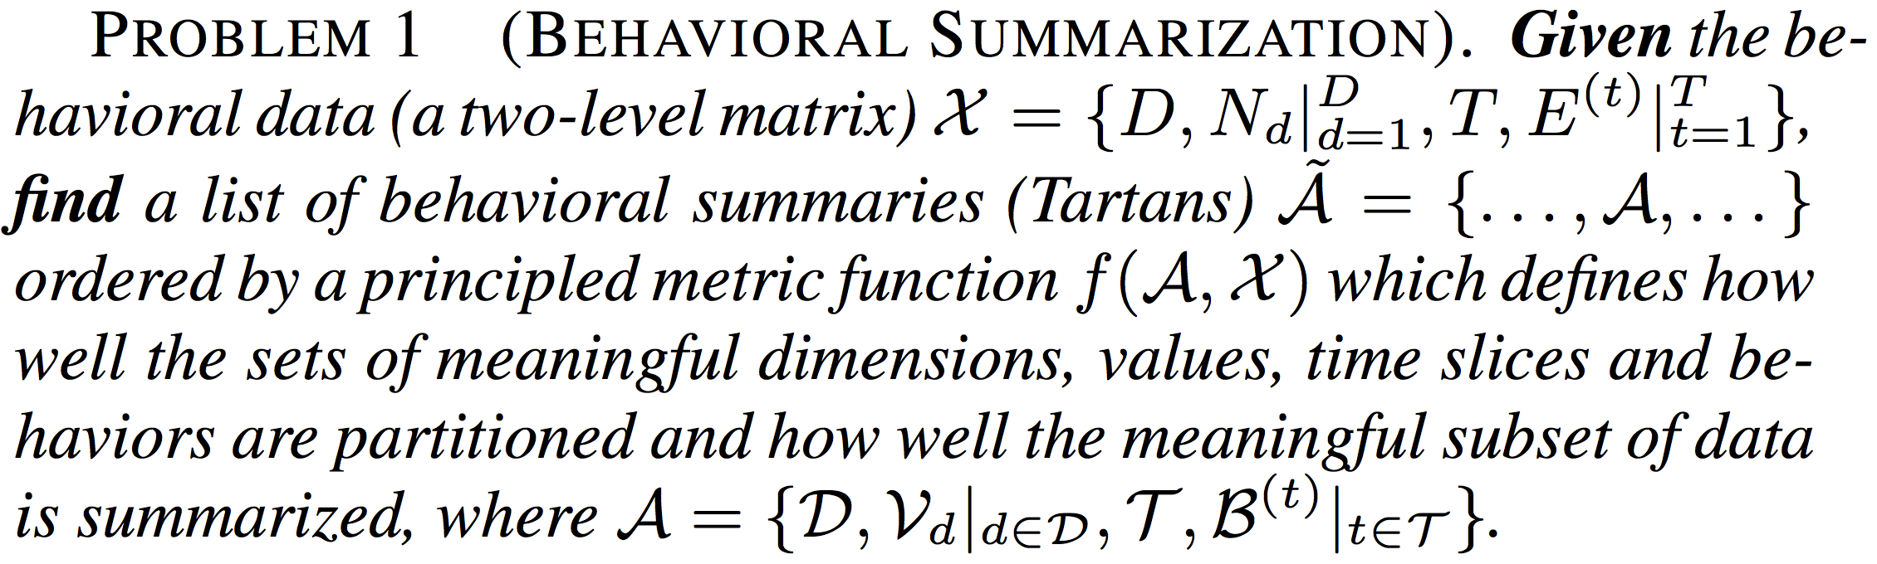
The Problem of Behavioral Summarization

Slide 14
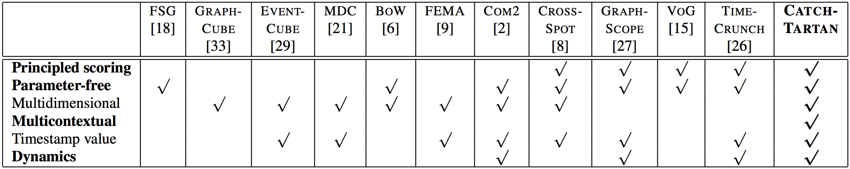
CATCHTARTAN
Employing a lossless encoding scheme
The Minimum Description Length (MDL) principle
Estimating the number of bits that encoding the Tartan can save from merging the meaningful pattern into the encoding of the data

Slide 15
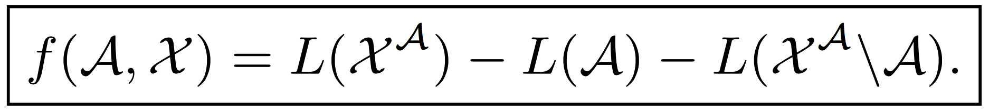
Objective Function to Maximize
Tartan
Data
First-level matrix
Individual entries

Slide 16
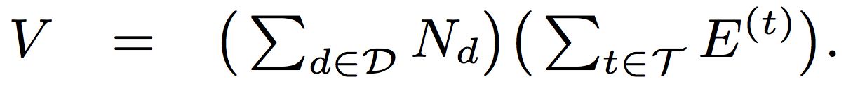
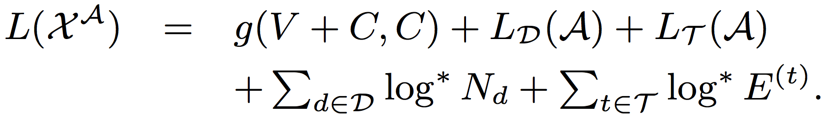
Objective Function to Maximize (cont.)

Slide 17
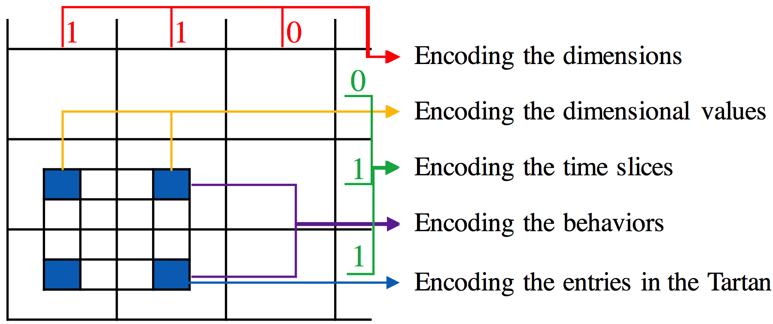
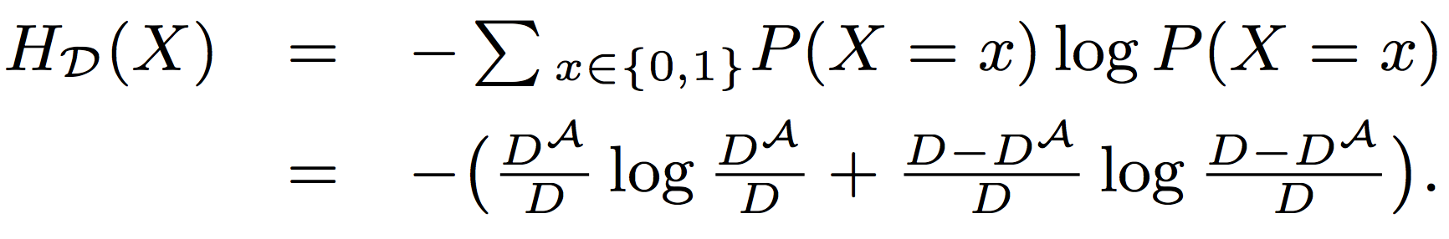
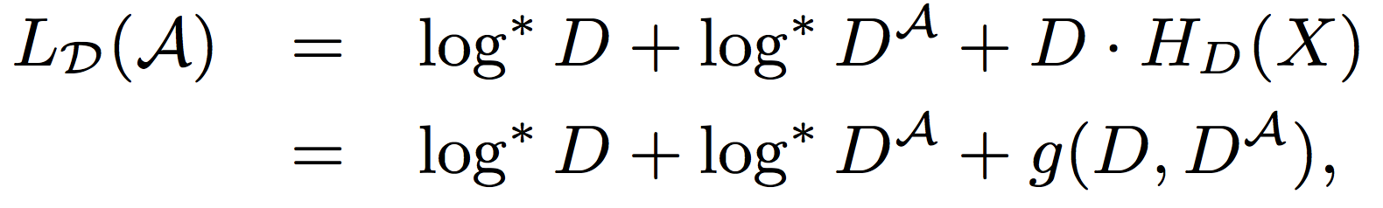
Encoding the Tartan: Dimensions

Slide 18
Encoding the Tartan: Dimensional Values

Slide 19
Encoding the Tartan: Time Slices

Slide 20
Encoding the Tartan: Behaviors

Slide 21
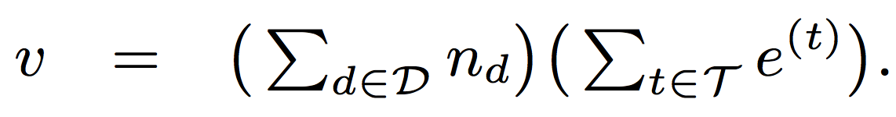
Encoding the Tartan: Entries

Slide 22
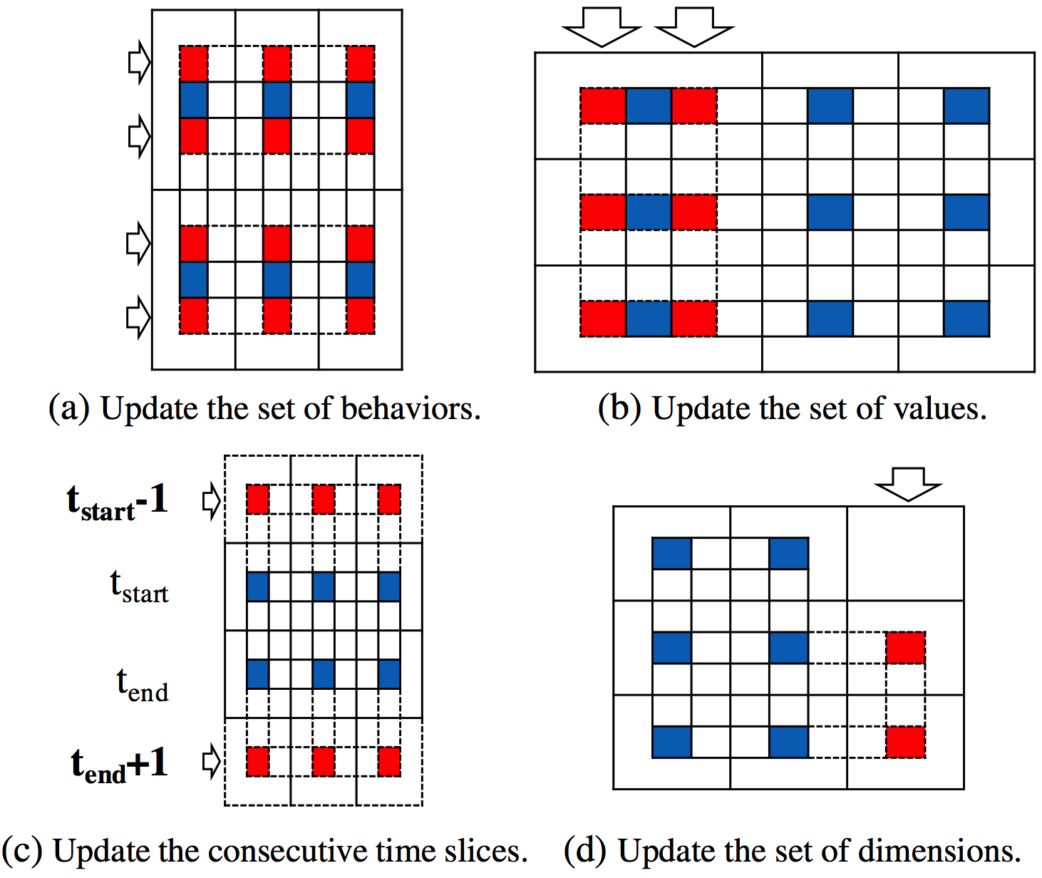
Greedy Search for the Local Minimum
Time complexity:

Slide 23
Qualitative Analysis: DBLP data

Slide 24
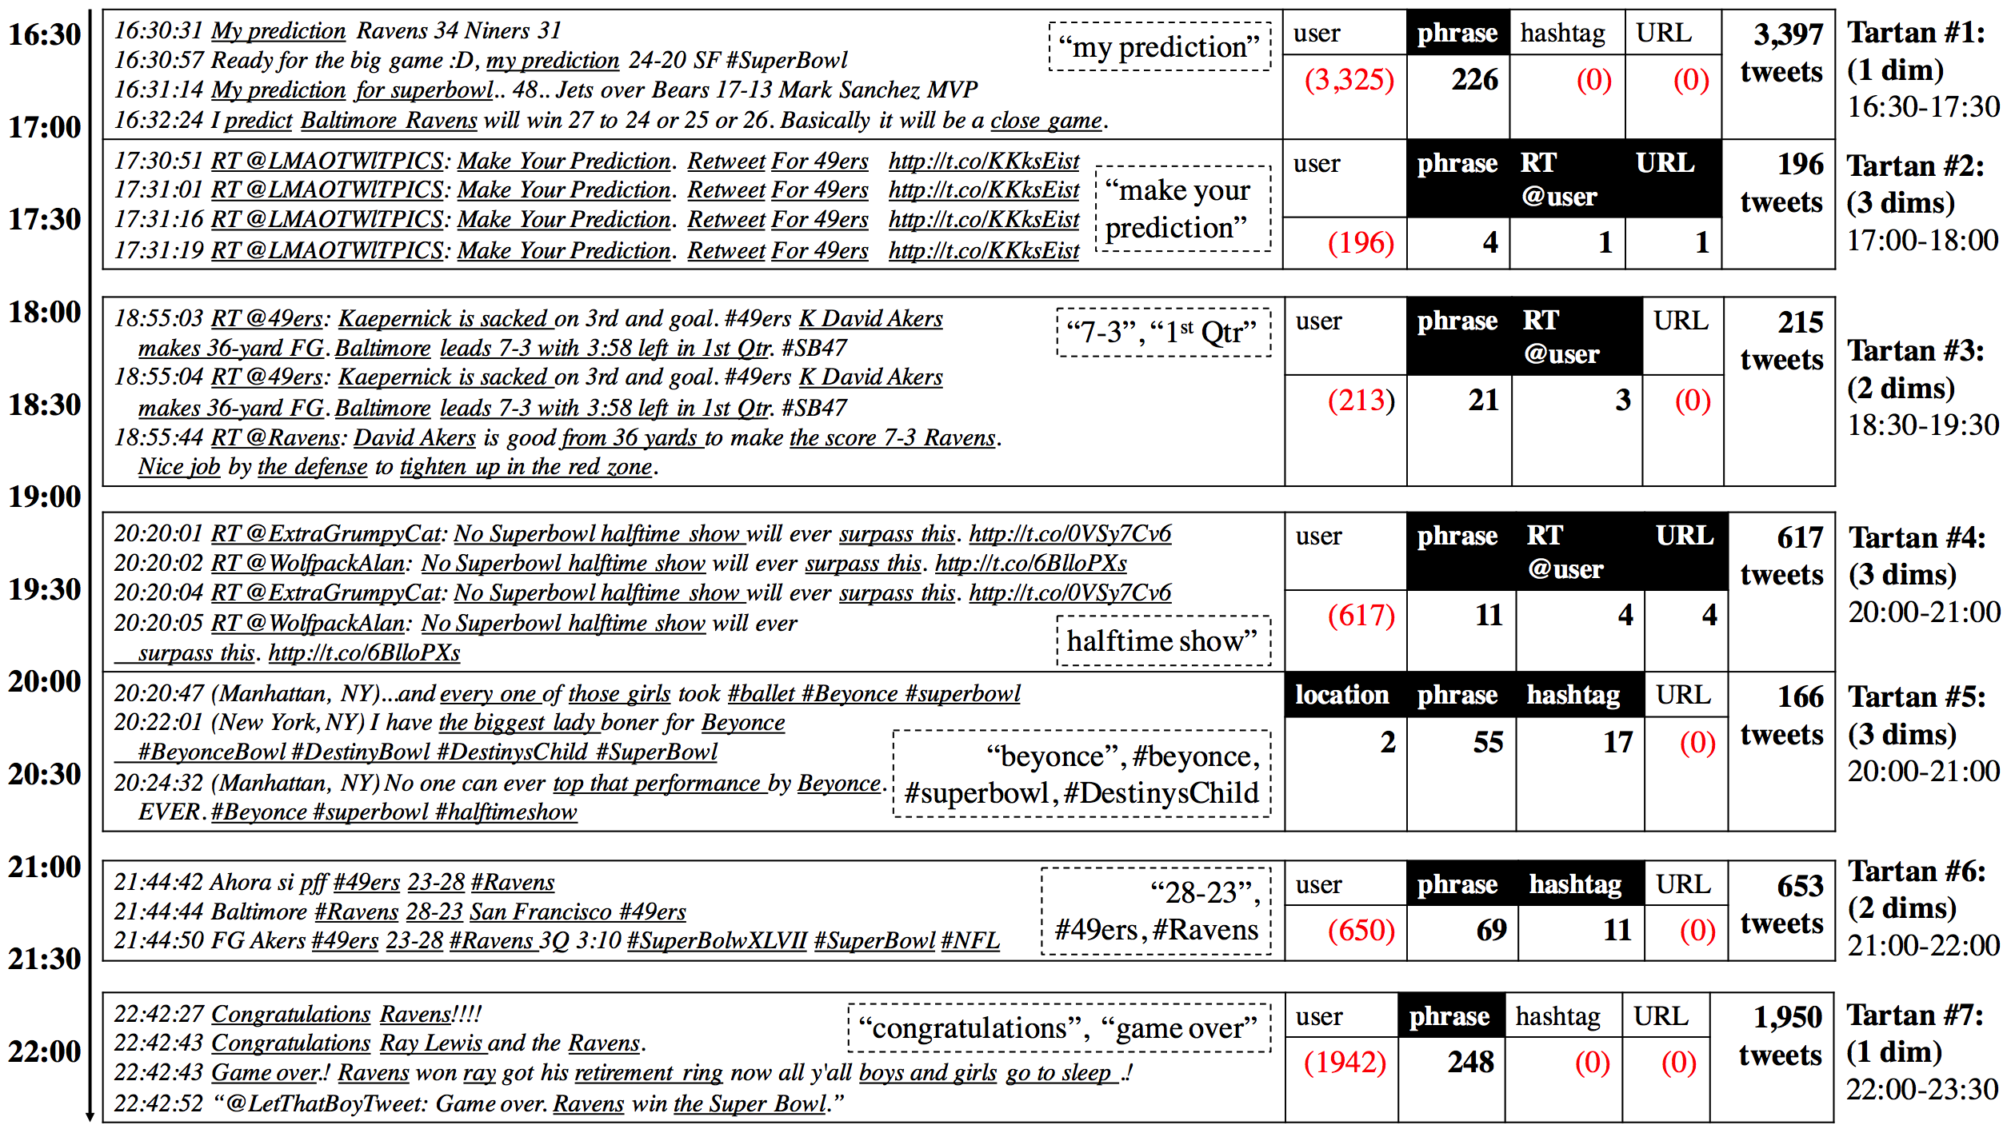
Qualitative Analysis: Super Bowl 2013

Slide 25
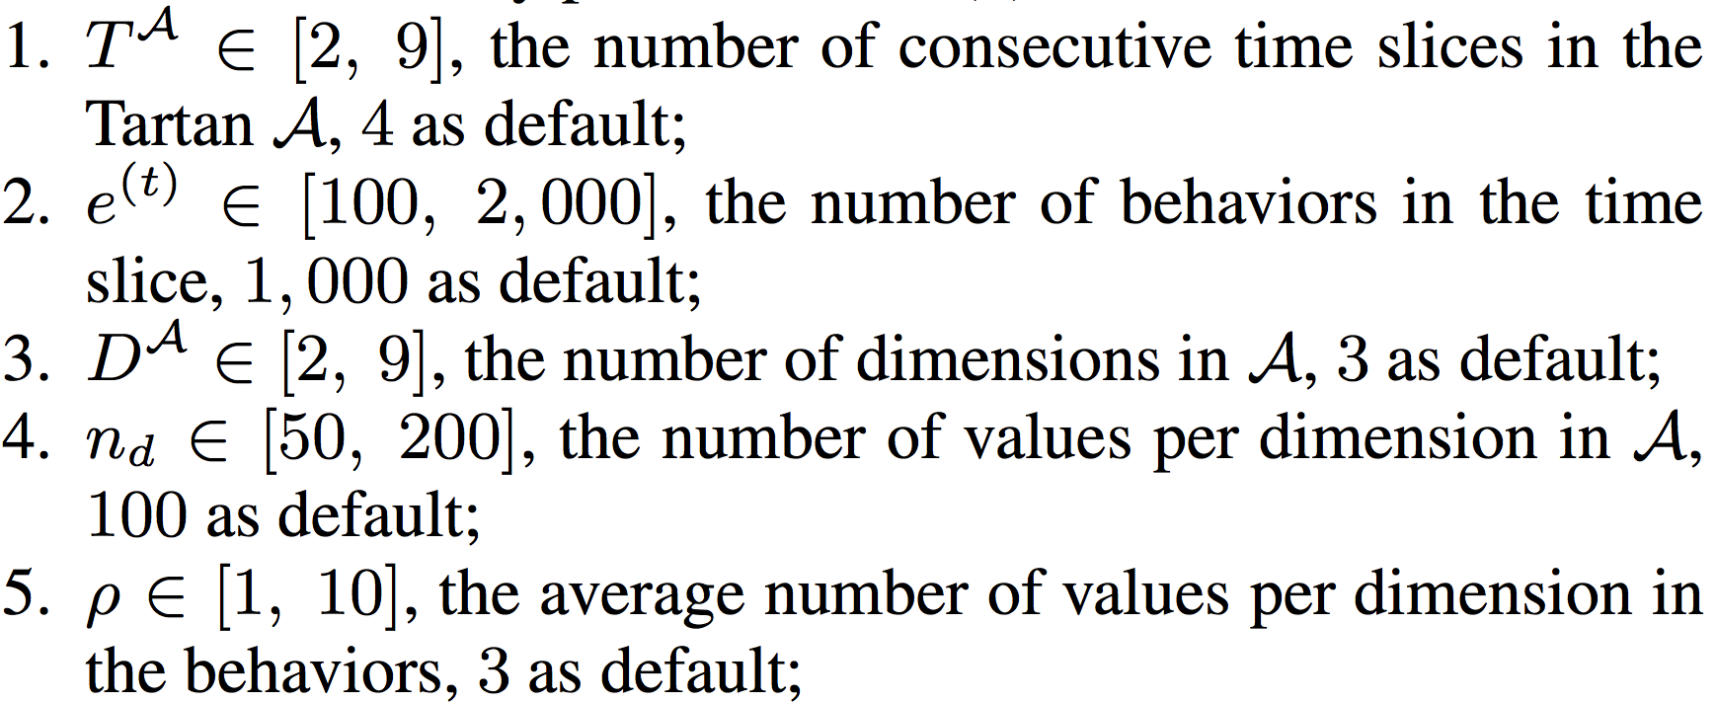
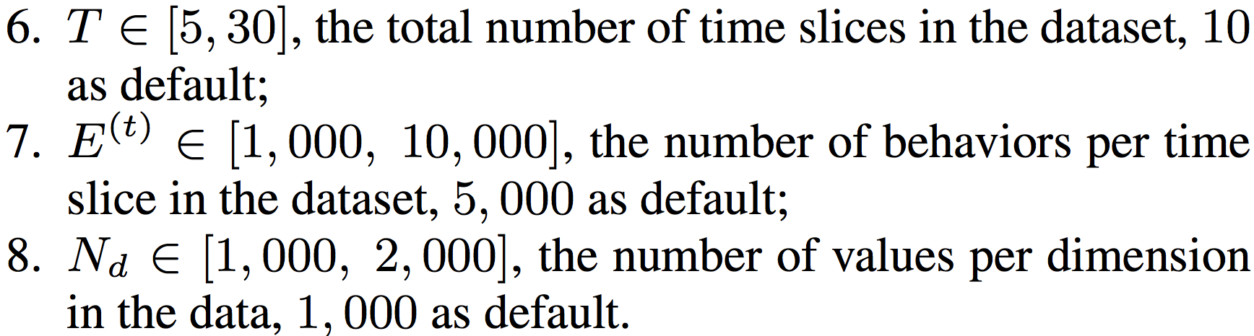
Quantitative Analysis: Accuracy and Efficiency in Synthetic Experiments
Tartan distribution
Data distribution

Slide 26
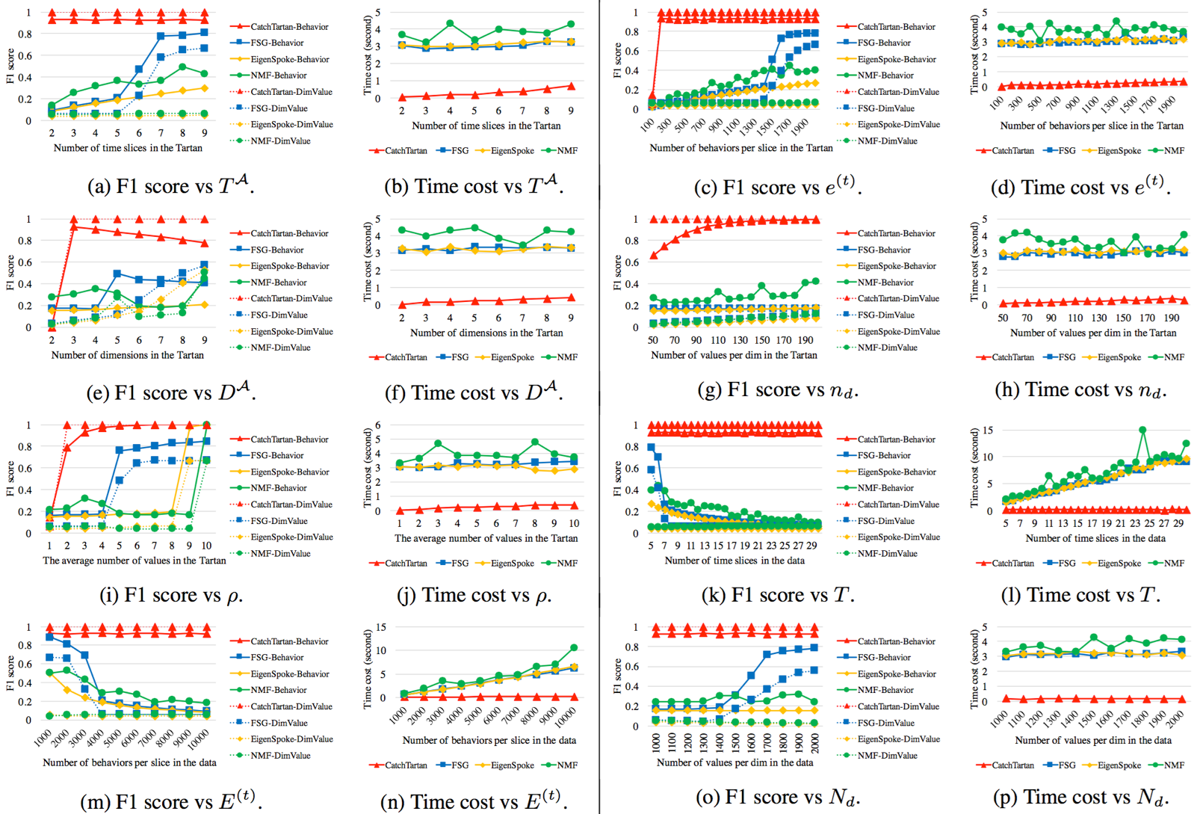

Slide 27
Summary
Novel representations
Behavior: “two-level matrix” vs. tensor
Behavioral summary: “Tartan” vs. dense block
A new summarization algorithm
Principled-scoring and Parameter-free: Objective function based on Minimum Description Length
Scalable: Greedy search for local optimum
Effectiveness, discovery and efficiency

Slide 28
Thank you!
CatchTartan: Representing and Summarizing Dynamic Multicontextual Behaviors
www.meng-jiang.com

Slide 29
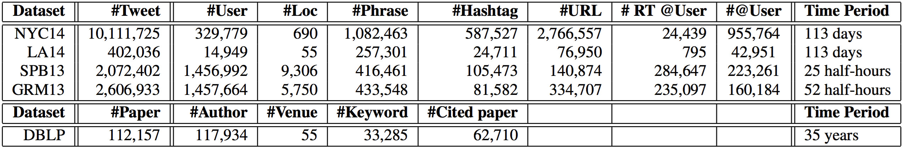
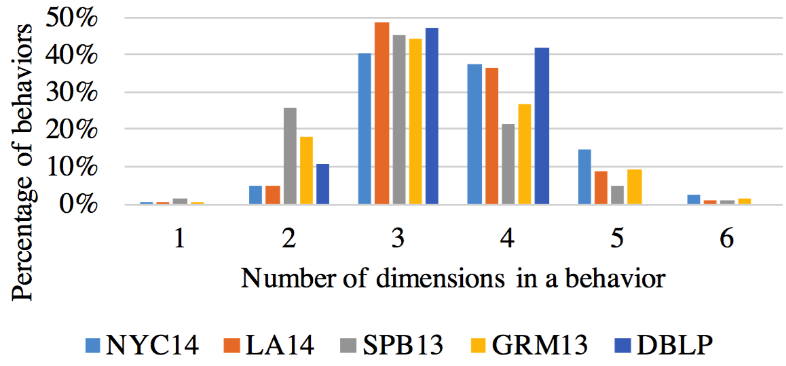
The Distributions in Real Data

Slide 30
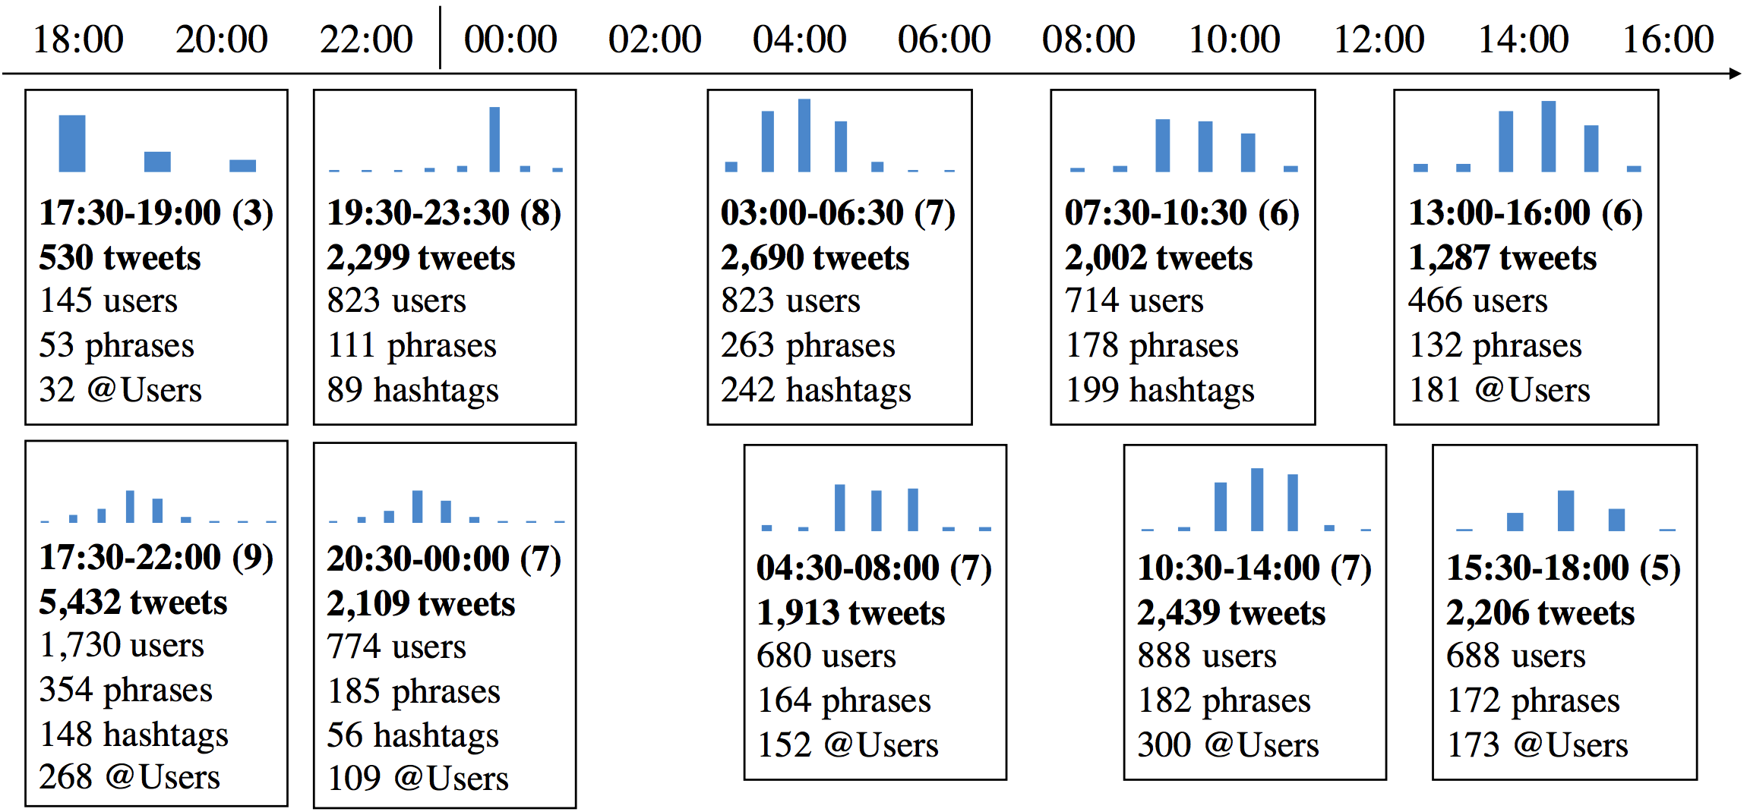
Qualitative Analysis: Grammy 2013

Slide 31
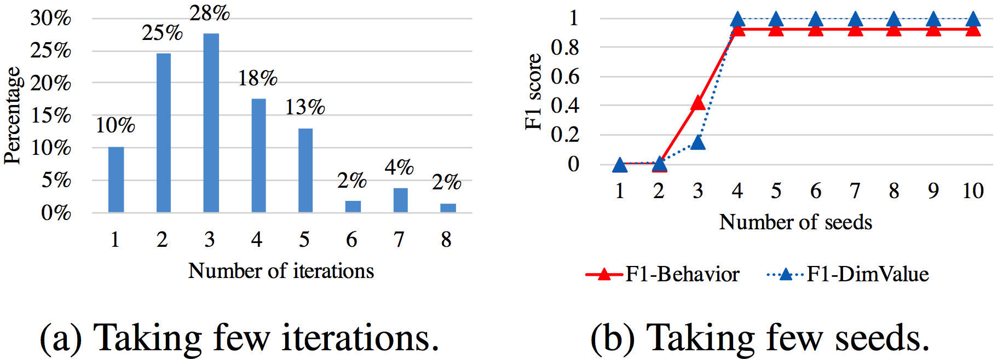
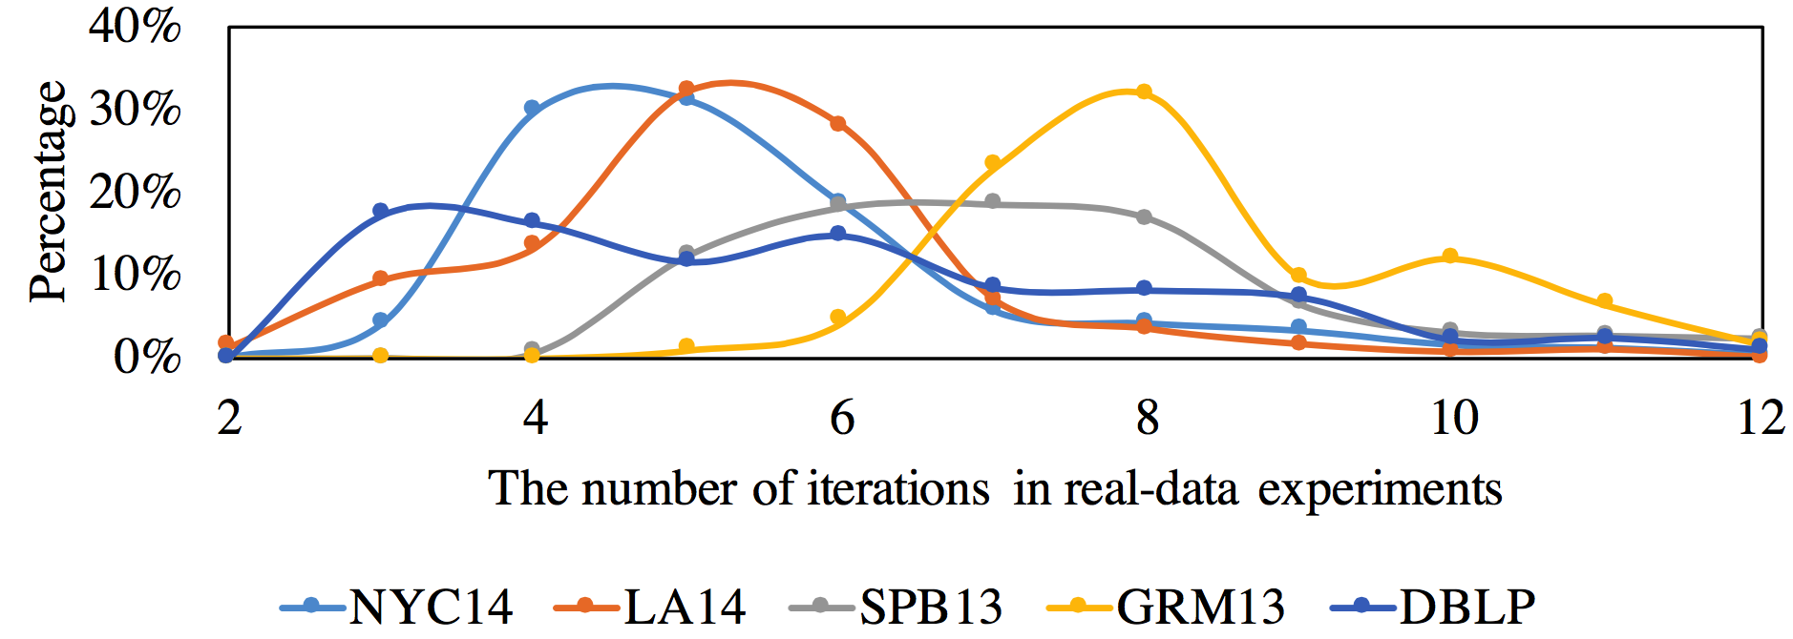
Convergence
Synthetic test
Real-data test

Slide 32
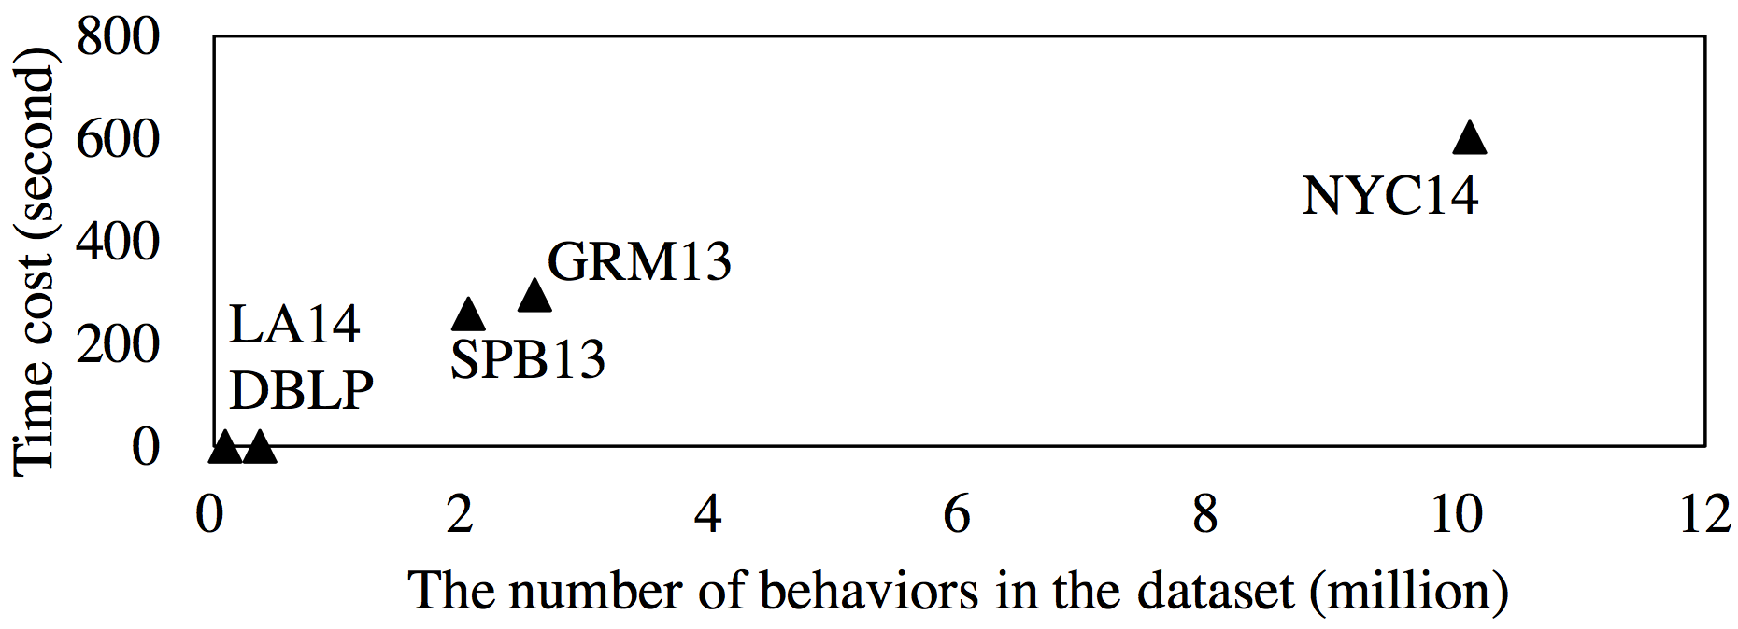
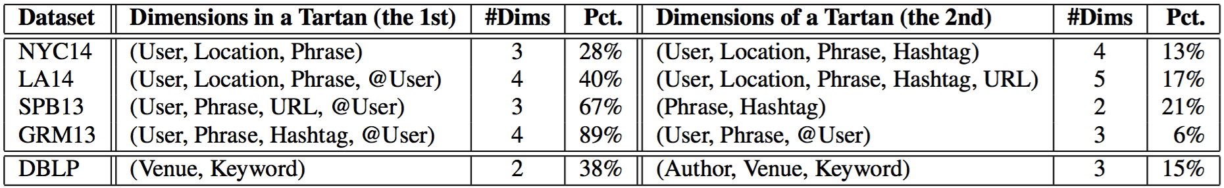
Efficiency and Tartan Distributions

Slide 33
Things Related with “Two-Level” Matrix
Time-evolving heterogeneous networks
Bipartite one-to-many graph
p1
t₁
 |  | Author |  | Venue
Papers | t₁ | 1 |  | 1
 |  | 1 | 1 |  | 1
 |  | ... | … | … | …
 | t₂ | 1 | 1 | 1
 |  | 1 | 1 |  | 1
 |  | … | … | … | …
a1
v1
p₁
p₂
…
p₃
p₄
…
p2
a2
v2
p3
t₂
p4
a₁ | a₂ | v₁ | v₂

Slide 34
Things Related with “Two-Level” Matrix (cont.)
Time-evolving heterogeneous networks
Relationships
p1
t₁
 |  | Author |  | Paper |  | Venue
Relationsihps | t₁ | 1 |  | 1
 |  | 1 |  |  | 1
 |  | ... | … | ... | … | … | …
 | t₂
 |  | … | … | … | … | … | …
a1
v1
p2
a2
v2
p3
t₂
p4
a₁ | a₂ | p₁ | p₂ | v₁ | v₂

Slide 35
Things Related with “Two-Level” Matrix (cont.)
The Meta-Path similarity metric
 |  | Author |  | Venue
Papers | t₁ | 1 |  | 1
 |  | 1 | 1 |  | 1
 |  | ... | … | … | …
p1
p₁
p₂
…
a1
v1
p2
 |  | Author |  | Venue
Papers | t₁ | 1 |  | 1
 |  | 1 | 1 |  | 1
 |  | ... | … | … | …
 | t₂ | 1 | 1 | 1
 |  | 1 | 1 |  | 1
 |  | … | … | … | …
a2
v2
p3
p₁
p₂
…
p₃
p₄
…
p4
Author – Paper – Author
Author – Paper – Venue – Paper – Author
a₁ | a₂ | v₁ | v₂

